Slide 1
FILE MANAGEMENT SOFTWARE
Presented By: GROUP-4
Swetha Devisetty - 46291226
Bhargavi Dumpa - 46290147
Rohitha Attili - 46290148
Adapa Devi Saranya - 46290149
Jyosna Sri Kalabattula - 46290150

Slide 2

Contents
Abstract
Introduction Functionalities Project Objectives System Requirements
Technical Requirements System Features Advantages
Future Enhancement

Slide 3

Abstract
File Management Software is mainly discussing about the authenticated accessibilities of the files. The purpose of this project is to show the requirements to the user for the file management software which stores the files in the local machine. Based on an interaction between client and server the files can be accessed to upload, download, display and delete operations.

Slide 4

Introduction
The file is a collection of related information that is recorded on storage device.
It is a way of data collection which is used as medium of giving an input and collecting output from an application.
This software has limited capabilities and it is designed to manage individual file operations.
File Management Software is also known as File Manager.
It also improves the overall function of a business workflow.

Slide 5
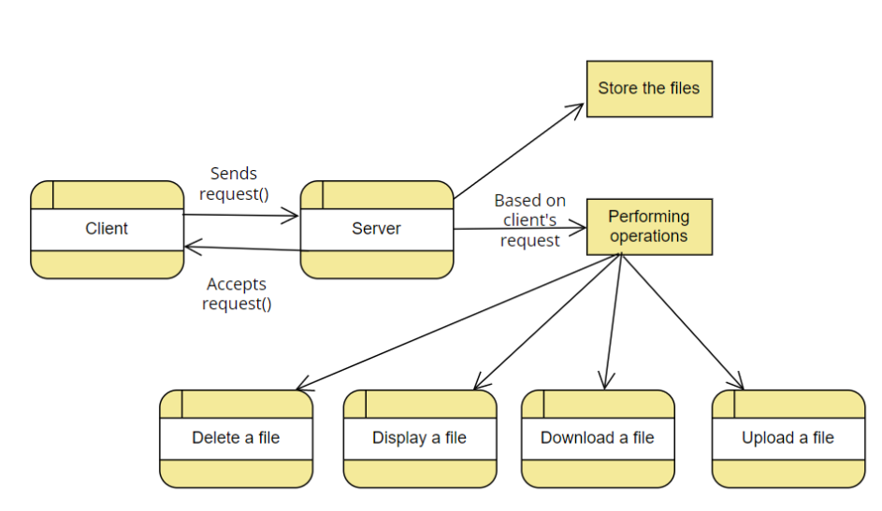
System Design

Slide 6

Functionalities
Authenticate with username and password
List all the files downloaded from server
List all the files
Sends request to download a file
Sends request to
accept the file
Sends request to
delete a file
Sends request to end
the connection
Connection
establishment

Slide 7


Functionalities
Sends request to download a file and store it
Downloaded files are stored and displayed
Files in server are to be displayed
Requests file to accept
and upload in server
Disconnect the connection between client and server.
Request server to delete a file

Slide 8

Project Objectives
This project
deals with file where we can
management,
facilitate upload, files.
the user to display,
download and delete
Multiple users will be able to access the files.
Secured access has provided to the users users can store the file.
been
so the

Slide 9
System Requirements
Software Interface:
Operating System : Linux OS which supports networking.
Connect Protocol : TCP Protocol
Hardware Interface:
Processor
ROM
RAM
Hard Disk
: i3 and above
: 1TB (SSD/HDD)
: 8GB and above
: 128 GB

Slide 10

Technical Requirements
Process Synchronization
Shared memory in Linux
Socket Programming in C- TCP
Support for statistics
I/O Multiplexing
Logging and debugging framework
Tools Used:
Valgrind

Slide 11





System Features
Performance
Supportability
Reliability &
Availability
Design Constraint
Usability

Slide 12


Advantages
Improve productivity
Increase user accountability
Save money on paper costs
Promote transparent file tracking for archival and deletion
Can improve our organization to create, modify, access and share files

Slide 13

FUTURE ENHANCEMENTS
File management software organizes digital files for enhanced functionality
It enhances systems boost
companies digital security

Slide 14
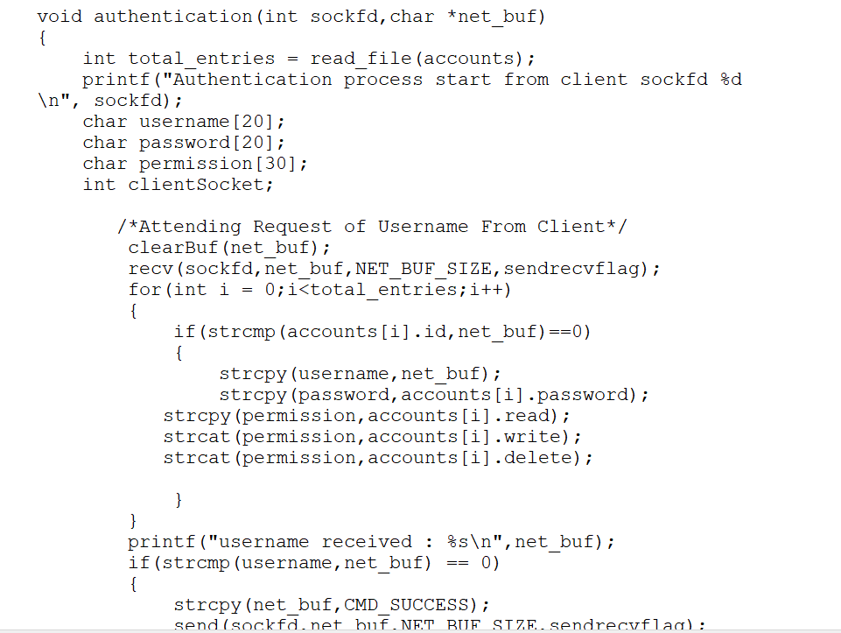
Code Snippet for User Authentication

Slide 15
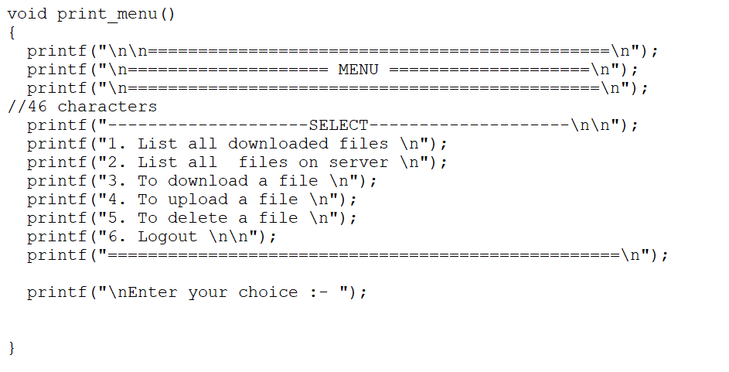
Code Snippet for File Menu

Slide 16
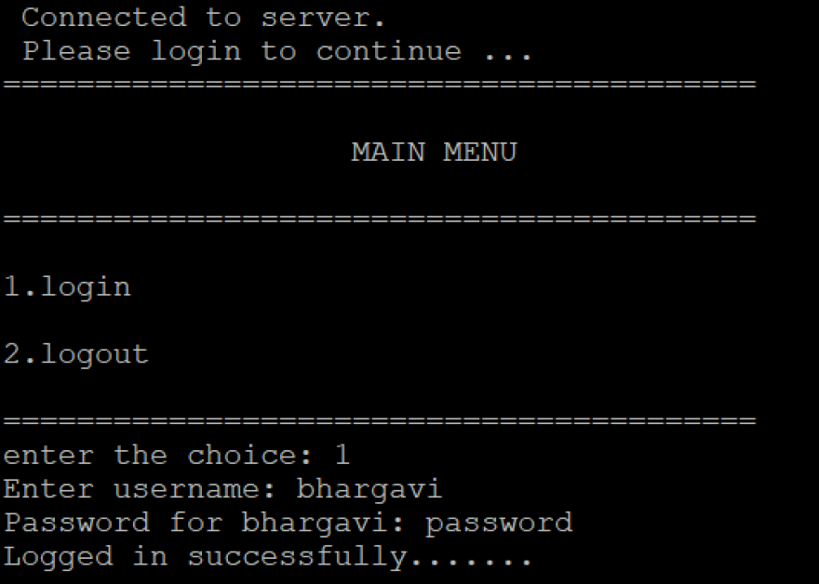
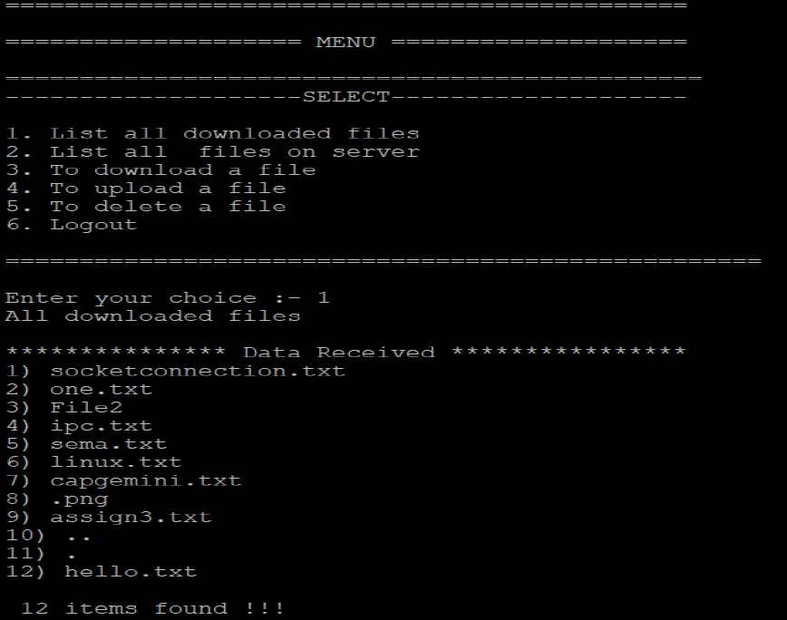
Sample Output

Slide 17
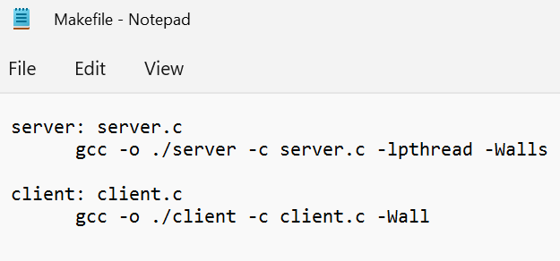
Make File

Slide 18
THANK YOU

